Slide 1
Microprocessors, Microcontrollers & Embedded systems
8051

Slide 2
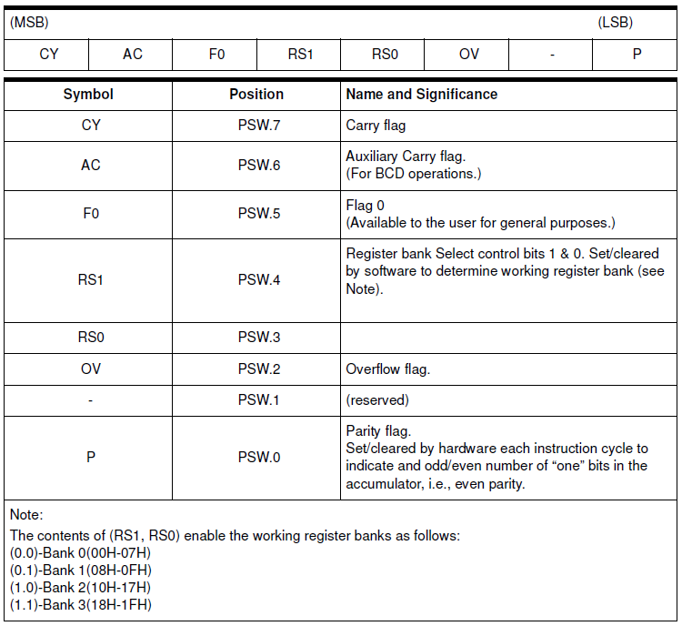
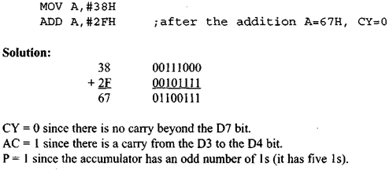
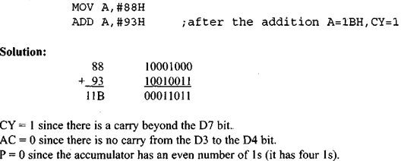
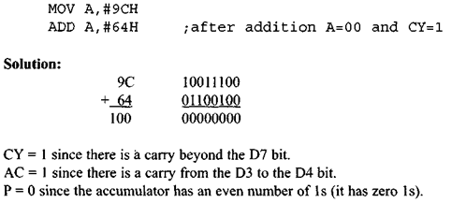
8051 Instruction Set
PSW
Addressing modes
Instructions
Arithmetic
Logical
Data transfer
Boolean manipulation
Program branching
PSW

Slide 3
8051 Instruction Set
Addressing modes
Direct addressing
Indirect addressing
Indexed addressing
Register instruction
Register-specific instruction
Immediate constants
Notes:
Register-specific instruction can be grouped under Register instructions
Indexed addressing: Only Program Memory can be accessed with indexed addressing, and it can only be read. This addressing mode is intended for reading look-up tables in Program Memory. A 16-bit base register (either DPTR or the Program Counter) points to the base of the table, and the Accumulator is set up with the table entry number. The address of the table entry in Program Memory is formed by adding the Accumulator data to the base pointer.

Slide 4
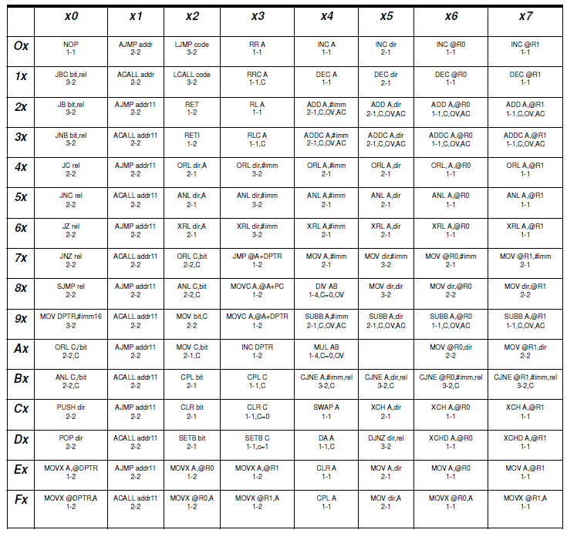
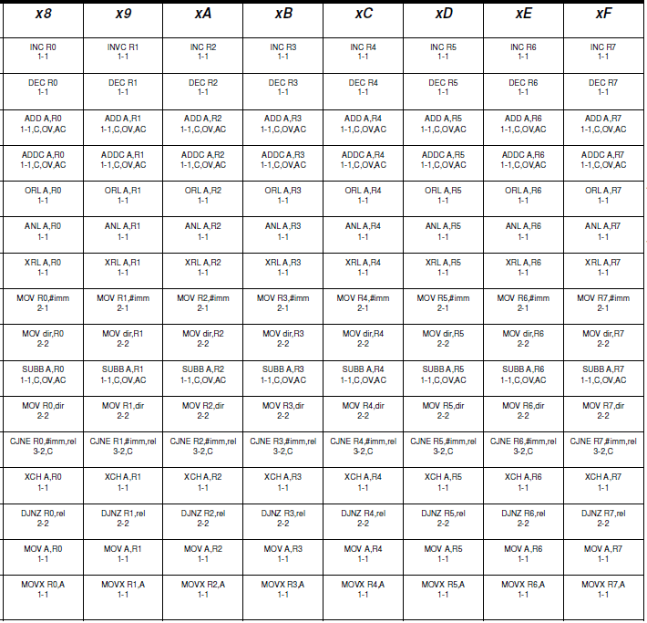
8051 Instruction Set

Slide 5
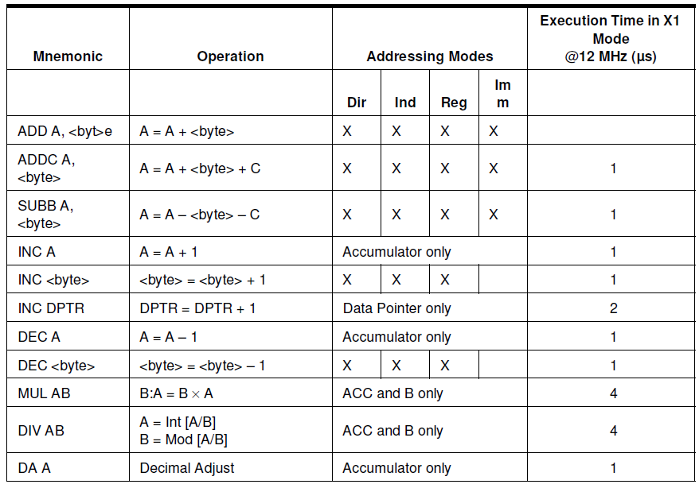
8051 Instruction Set
Arithmetic operations
Instructions
Arithmetic
Logical
Data transfer
Boolean manipulation
Program branching

Slide 6
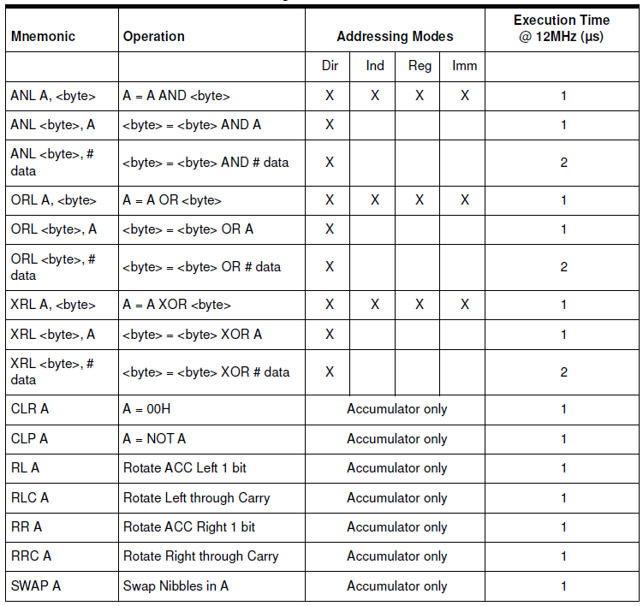
8051 Instruction Set
Logic operations
Instructions
Arithmetic
Logical
Data transfer
Boolean manipulation
Program branching

Slide 7
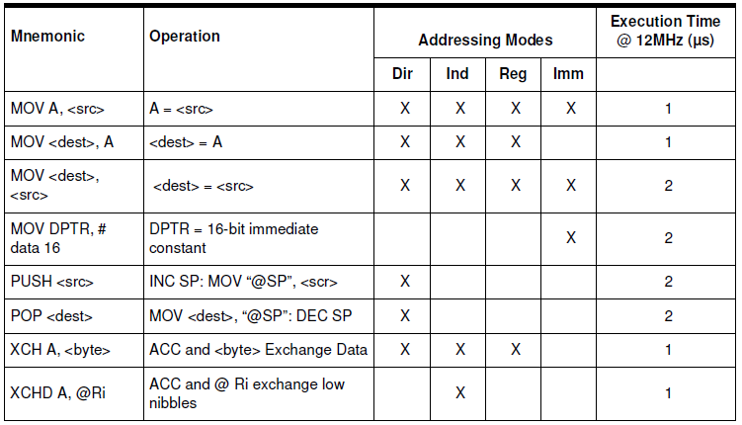
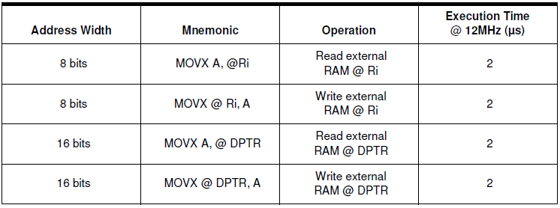
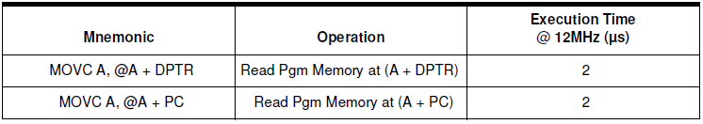
8051 Instruction Set
Data transfer operations
Instructions
Arithmetic
Logical
Data transfer
Boolean manipulation
Program branching
Indirect addressing
Indexed
addressing

Slide 8
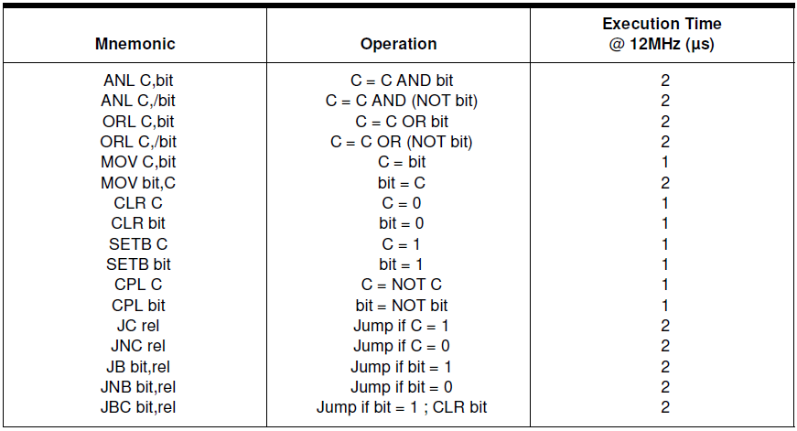
8051 Instruction Set
Boolean manipulation operations
Instructions
Arithmetic
Logical
Data transfer
Boolean manipulation
Program branching

Slide 9
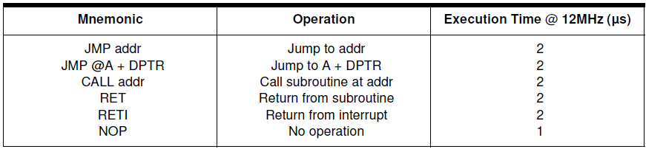
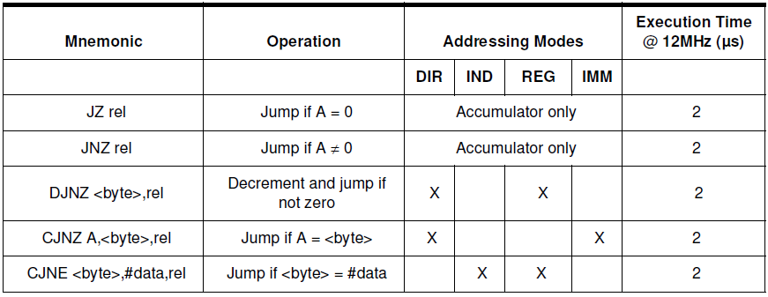
8051 Instruction Set
Program branching operations
Instructions
Arithmetic
Logical
Data transfer
Boolean manipulation
Program branching
Conditional jump
Notes:
SJMP, LJMP, AJMP missing

Slide 10
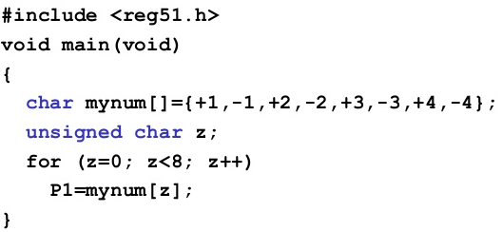
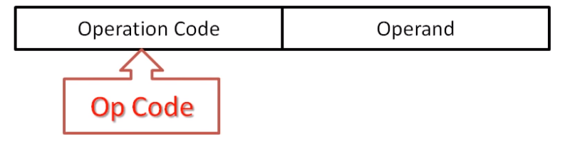

8051 Instruction Set
Instructions
High-level code:
Assembly code:
Machine code:
Compiler
Assembler
https://open4tech.com/boot-process-microcontroller/
Embedded Basics – Understanding the Microcontroller Boot Process: https://www.beningo.com/understanding-the-microcontroller-boot-process/
https://www.oreilly.com/library/view/programming-embedded-systems/0596009836/ch04.html

Slide 11
8051 Interrupts
An event (external/internal) that interrupts the controller to inform that a device needs its service
Interrupts "put on hold" the normal program flow, execute a dedicated piece of code (interrupt handler or ISR), and resume normal program flow as if we had never left it
Interrupts are convenient & efficient than to manually check for status of the event (polling)
Events can be one of
Timers 0 or 1 overflowing
Receive or transmit a character via serial port
One of the two external events
Reset
Complete execution of instruction
void main()
{
while(1)
{
Line 1
Line 2
Line 3
Line 4
Line 5
….
….
….
Line N
}
}
Push the PC; Save interrupt status
Interrupt
Jump to ISR and continue execution
ISR
ISR
ISR
Upon RETI, pop PC from stack
Main
Main
Main
Main
Time

Slide 12
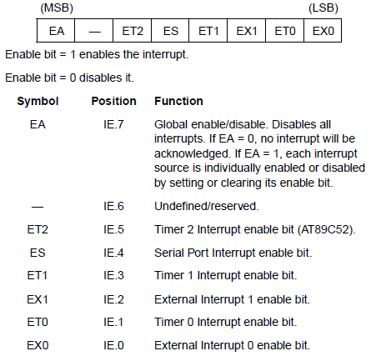
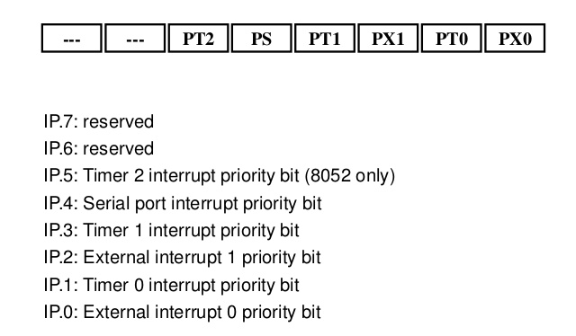
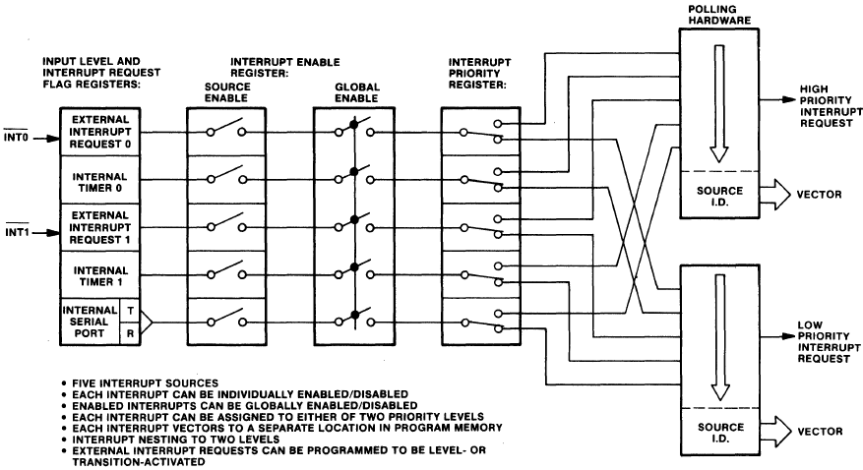
8051 Interrupts
Interrupt Enable (IE) Register
Interrupt Priority (IP) Register
All interrupts are disabled after reset
While processing ISR, interrupt is automatically cleared, except RI/TI
IE register allows enabling/disabling Interrupts
IP register permits altering priority
Interrupt | Priority (0:Highest 5: Lowest) | ISR address | Remarks
External Interrupt 0 | 1 | 0x0003 | Only 8 memory locations between ISRs? What can you code in it?
Timer 0 Overflow | 2 | 0x000B
External Interrupt 1 | 3 | 0x0013
Timer 1 Overflow | 4 | 0x001B
Serial Port | 5 | 0x0023
Timer 2 Overflow (8052+) |  | 0x002B
Reset | 0 | ?
https://www.slideserve.com/osbourne/interrupt
https://www.slideshare.net/daniemol/8-interrupt-8051

